Slide 1
jQuery Andrew Cumming
Write less, do more…

Slide 2
Lecture Plan
jQuery – what and why
The ready function
Creating Content
Changing Elements
Applying CSS
Applying functions
Lists of useful JavaScript and jQuery functions
Arrays and Objects in JavaScript

Slide 3
jQuery – What and Why
Write less, do more
jQuery is a JavaScript library
It makes writing JavaScript easier
It smooth out some browser incompatibilities
It is one of the most successful libraries

Slide 4
JavaScript is unavoidable
HTML and CSS and JavaScript (ECMA Script) are built into the browsers and built into the W3C specifications. They cannot be avoided.
Unfortunately JavaScript has been implemented rather differently in different browsers.
The programmer has to write different code for each browser (IE6, IE8, Firefox, Opera etc.)
The jQuery library takes care of these differences.
jQuery will be compatible with new browsers (probably)

Slide 5
jQuery adds functionality
jQuery provides additional functions.
It provides the programmer with a large number of easy to use methods.
It allows you to write complex scripts in just a few lines.
It demands an unusual style of programming.

Slide 6
Preliminaries
<script
src="https://code.jquery.com/jquery.min.js">
</script>
You can download the library from google.
This means it may be your user’s cache.
$(function(){alert(42)})
This is the ready function.
$ takes a function as a parameter.
The function is executed when the page has loaded.
This is a useful time to set up the page

Slide 7
Example
The HTML page – home.html
<!doctype html>
<html>
<head><title>Timetables</title>
<script src='https://code.jquery.com/jquery.min.js'> </script>
<script src='hello.js'></script>
</head>
<body>
<div id='container'>
…
The JavaScript page – hello.js
// hello.js
$(function(){
alert("Hello world");
});

Slide 8
The Anonymous Function
This statement:
Creates a function.
Sends that function to the ready function.
The Anonymous Function will execute when the page is ready.
$(
function(){
alert("Hello world");
}
);

Slide 9
Creating Content
You can create content using the $ function.
You can add the content to your page using the append method.
$(function(){
var msg = $('<div>Hello World</div>');
$('body').append(msg);
});

Slide 10
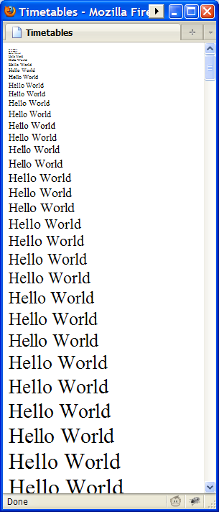
Creating Content and Changing it
After you create a node you can change it:
$(function(){
for (var i=0;i<100;i++){
var msg = $('<div>Hello World</div>');
msg.css('font-size',i);
$('body').append(msg);
}
});

Slide 11
Some Useful jQuery functions
$
Ready function, create elements, find elements
append
The append function adds to the end of an element
prepend
The prepend function adds to the beginning of an element
css
The function css is used to set a css property of an element
html
Change the contents

Slide 12
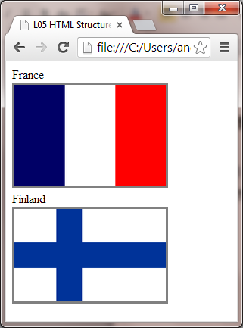
Creating structures
You often need to create elements that contain other elements.
<div id='countries'>
<div id='fr'>
<div>France</div>
<img src='flags/fr.gif'/>
</div>
<div id='fi'>
<div>Finland</div>
<img src='flags/fi.gif'/>
</div>
</div>

Slide 13
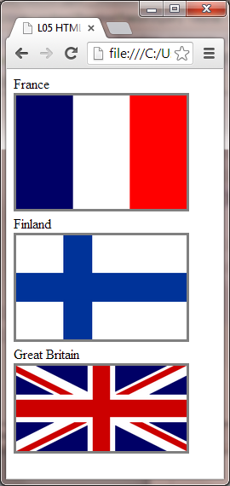
Adding another country
var gb = $('<div/>');
gb.append($('<div/>',{text:'Great Britain'}));
gb.append($('<img/>',{src:'flags/gb.gif'}));
$('#countries').append(gb);

Slide 14
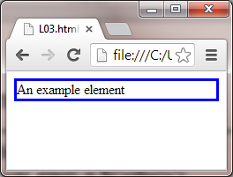
Examples of use
$(function(){
var elem = $('<div/>');
elem.html('An example element');
elem.css('border','solid blue');
$('body').append(elem);
})

Slide 15
Self Test
Select the correct ready function syntax
$()(function{alert(42);});
$(function()(alert(42);));
$(function(){alert(42);});
function $({alert(42);});
function $()({alert(42);});

Slide 16
Self Test
What is the missing word ____ in this code?
css
append
html
forfend
$
.
$(document).ready(function(){
var d = $('<div>42</div>')
d.css('color','red');
$('body').____(d);
});

Slide 17
Self Test
In the flags example each image has a grey border. Select the best way to achieve this in jQuery
$('#countries img',{css:{ border:'solid gray' }});
$('#countries img').{css:{ border:'solid gray' }};
$css('#countries img','border:solid grey');
$('#countries img').css('border','solid grey')

Slide 18
Selecting existing items
You can select items with the $ function
The result is a list of items
$('li').css('color','red');
Locate all <li> elements and make them red.
$('.reference').css('background-color','red');
Locate all elements with css class=‘reference’
$('#menu1').css('border','solid thick red');
Locate the element with id “menu1”

Slide 19
Select items with items
A common pattern is to select elements within a named element:
table#main td
Select all td elements within the table with id main
ul#nav li
Select all li elements inside the ul named nav

Slide 20
Selecting Existing Items
You can modify the selectors
$('p:first-child').css('border','solid');
Identifies the first p in each block
$('p:nth-child(1)').css('border','solid');
Selects the first child in each block
$('p:eq(1)').css('border','solid');
This gets item 1 – the second one
$('p:last').css('border','solid');
The last one of all

Slide 21
Combining terms
As with css you can combine terms.
When one term follows another separated by a space then the second is a descendant of the first
table tr td
div#content p
A > indicates a direct descendant, a child
ul.menu>li prevents nested li elements matching
A comma allows an independent rule - OR

Slide 22
Data Structures
What expression would give each of the following:
“Edinburgh”
-100
“EH14 5DT”
$(function(){
var ca = {
cname:"A J CUMMING",
caddress:{
street:"10 Colinton Rd",
town:"Edinburgh",
post_code:"EH14 5DT"
},
transaction:[
{whn:"2014-01-11",nar:"Cash Withdrawal",amt:-100},
{whn:"2014-01-11",nar:"BUS FARE",amt:-35}
]
};
alert(ca.transaction[1].nar);
})
ca.transaction[1].nar
This code gives “BUS FARE”

Slide 23
Data Structures used to create elements
We can set a whole load of properties when an element is created.
In this example we set the text property and the css property.
The css property is itself a complex object
var d = $('<div/>',{text:'Hello',css:{color:'green',border:'solid'}});

Slide 24
More to learn
You can navigate through the list
You can animate items
You can show, hide and toggle
You can apply functions to all items in the list
You can store data against elements and retrieve it.
You can use ajax functions
You can create other effects using add-ons

Slide 25
Summary
jQuery – what and why
The ready function
Creating Content
Changing Elements
Applying CSS
Applying functions
Lists of useful JavaScript and jQuery functions
Arrays and Objects in JavaScript
Tutorial material at http://progzoo.net/ew

